Slide 1
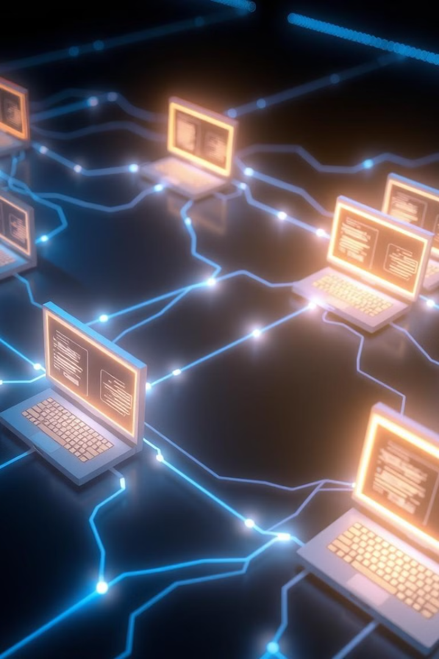

Understanding Cybersecurity Vulnerabilities
This presentation explores the nature of cybersecurity vulnerabilities and common threats, highlighting how vulnerabilities arise in various forms, and the steps we can take to mitigate risks.
by Pooja Shah

Slide 2

Definition of Vulnerabilities
Vulnerabilities are weaknesses in a system that could be exploited by an attacker. These flaws allow unauthorized access, data breaches, or disruptions in service.

Slide 3
Vulnerabilities vs. Threats vs. Risks
Vulnerabilities
Threats
Risks
Weaknesses in a system.
Potential actions that could exploit vulnerabilities.
The likelihood and impact of a threat exploiting a vulnerability.

Slide 4
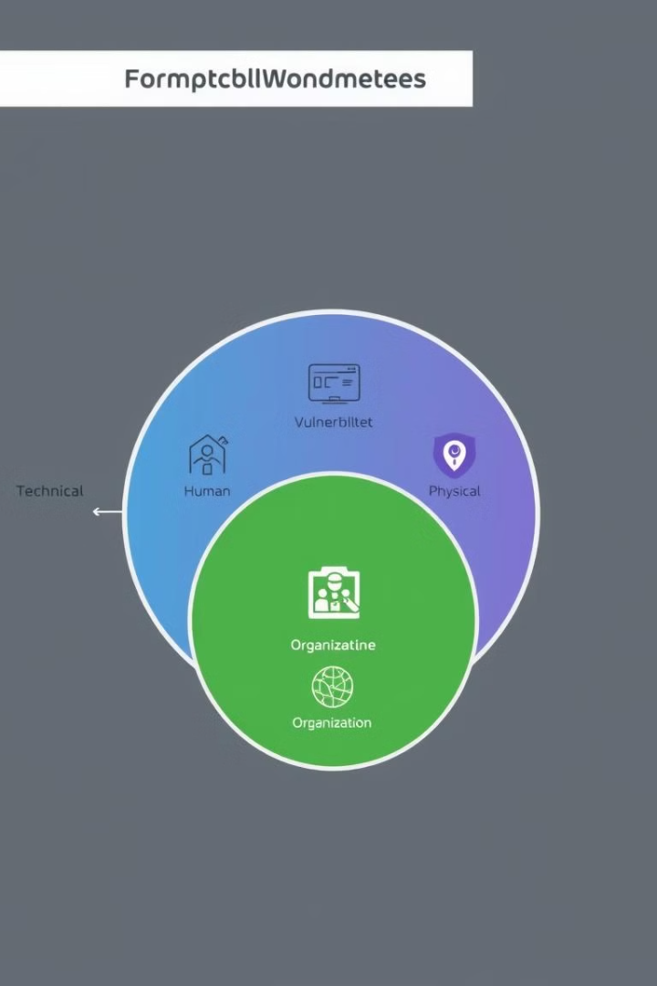
Categories of Vulnerabilities
Technical
Human
Software bugs, outdated systems, weak passwords.
Phishing scams, social engineering, careless practices.
Physical
Organizational
Unauthorized access to data centers, stolen devices.
Lack of security policies, insufficient training, poor incident response.

Slide 5
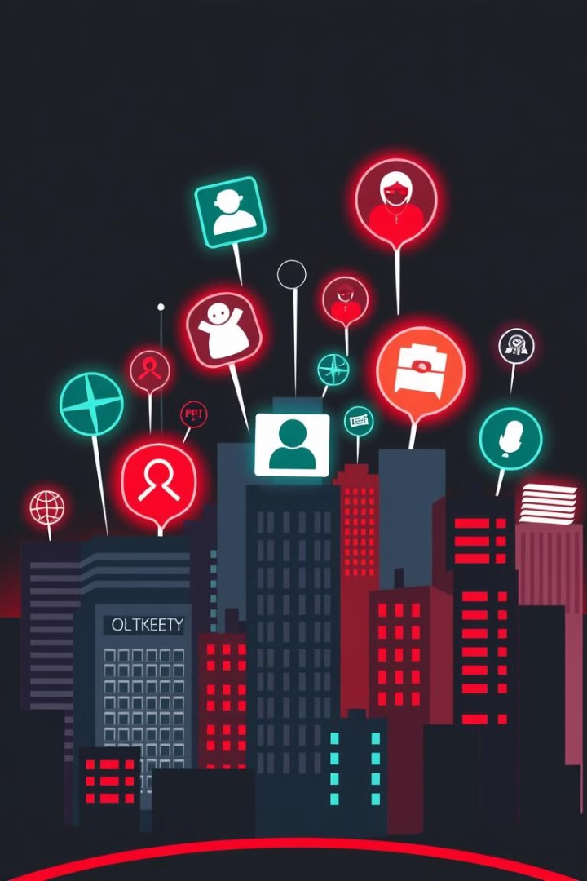
Common Cyber Threats
Cybersecurity threats are diverse, ranging from malicious software to social engineering attacks. Understanding these threats is crucial for developing effective defense strategies.

Slide 6
Malware
Viruses
Worms
Trojans
Self-replicating programs that infect and damage systems.
Spread without human interaction, often through networks.
Disguise as legitimate software but contain malicious code.
Ransomware
Spyware
Adware
Encrypts data and demands payment for decryption.
Collects user data without permission.
Displays unwanted advertisements.
Rootkits
Hide malicious activity from detection.

Slide 7

Phishing and Social Engineering
Social engineering involves manipulating people to gain access to sensitive information or systems. Phishing attacks use deceptive emails or websites to trick users into revealing credentials.

Slide 8
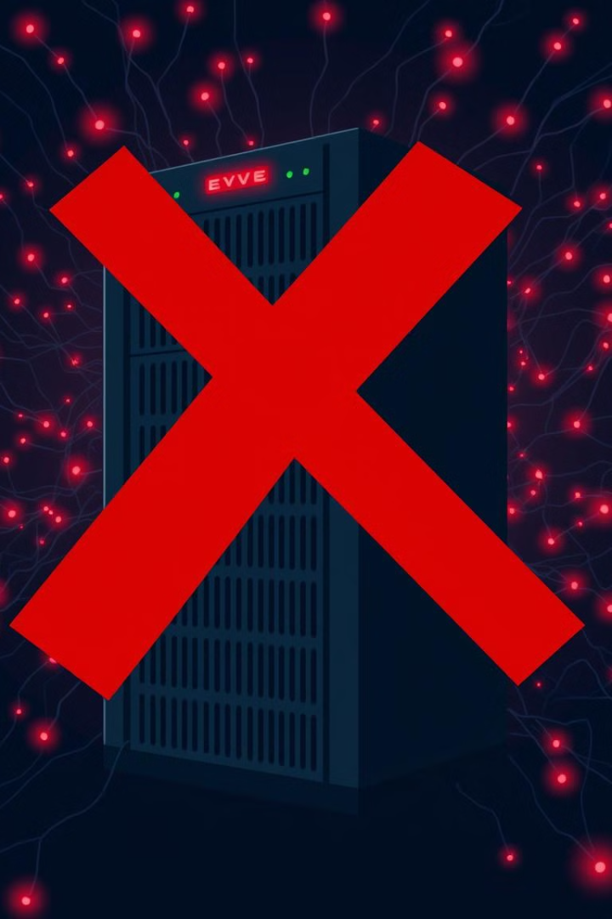
Denial of Service (DoS) and Distributed Denial of Service (DDoS) Attacks
DoS attacks flood a target system with traffic, overwhelming its resources and making it unavailable to legitimate users. DDoS attacks use multiple compromised systems to launch the attack, amplifying its impact.

Slide 9
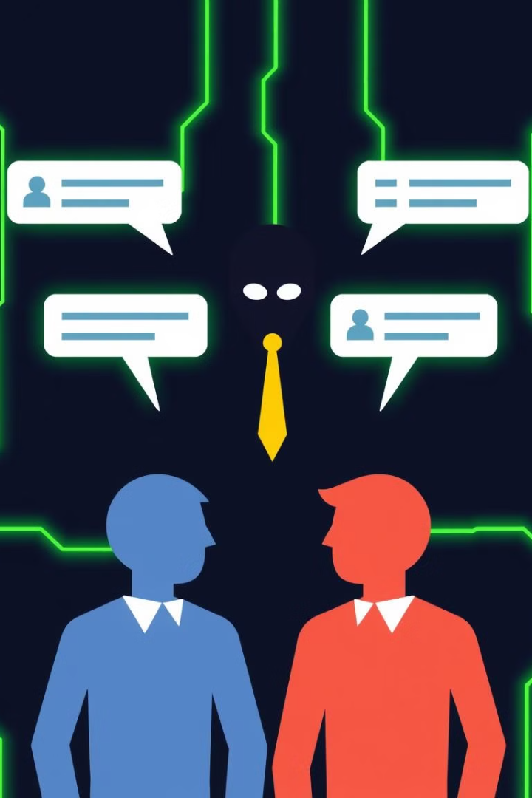
Man-in-the-Middle (MITM) Attacks
MITM attacks intercept communications between two parties, allowing the attacker to eavesdrop, modify, or even steal data.

Slide 10
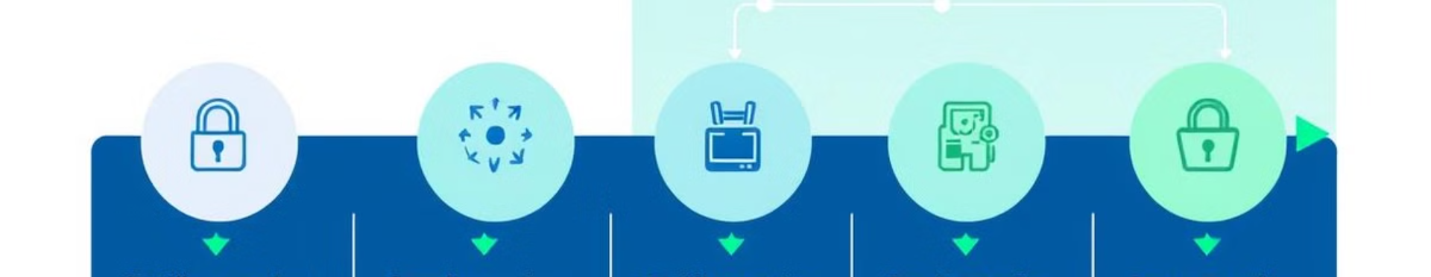
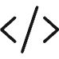

Software Development Lifecycle (SDLC) Security
Secure Coding Practices
Common Software Vulnerabilities
Writing code with security in mind to prevent vulnerabilities.
Insecure input handling, cross-site scripting, buffer overflows.

